Slide 1

Cloud Principles
Topic 1

Slide 2
Lesson Objectives
Objective 1: Understand the difference between cloud computing and on-premise computing.
1
Objective 2: Learn how to access major cloud platforms via portals, APIs, and SDKs.
2
Objective 3: Explore the definition, characteristics, and advantages of cloud computing.
3
Objective 4: Understand the relationship between Cloud Computing and Service-Oriented Architecture (SOA).
4
Objective 5: Discuss enterprise cloud drivers and adoption trends.
5

Slide 3
What is Cloud Computing?
"Cloud Computing is the delivery of computing services (servers, storage, databases, networking, software, analytics, etc.) over the internet ('the cloud')."

Slide 4
On-Premise vs Cloud
On-Premise Computing:
Infrastructure managed internally.
Requires significant upfront capital expenditure.
Scalability is limited by hardware availability.
Cloud Computing:
Infrastructure managed externally by cloud providers.
Follows a pay-as-you-go model.
High scalability and flexibility.

Slide 5
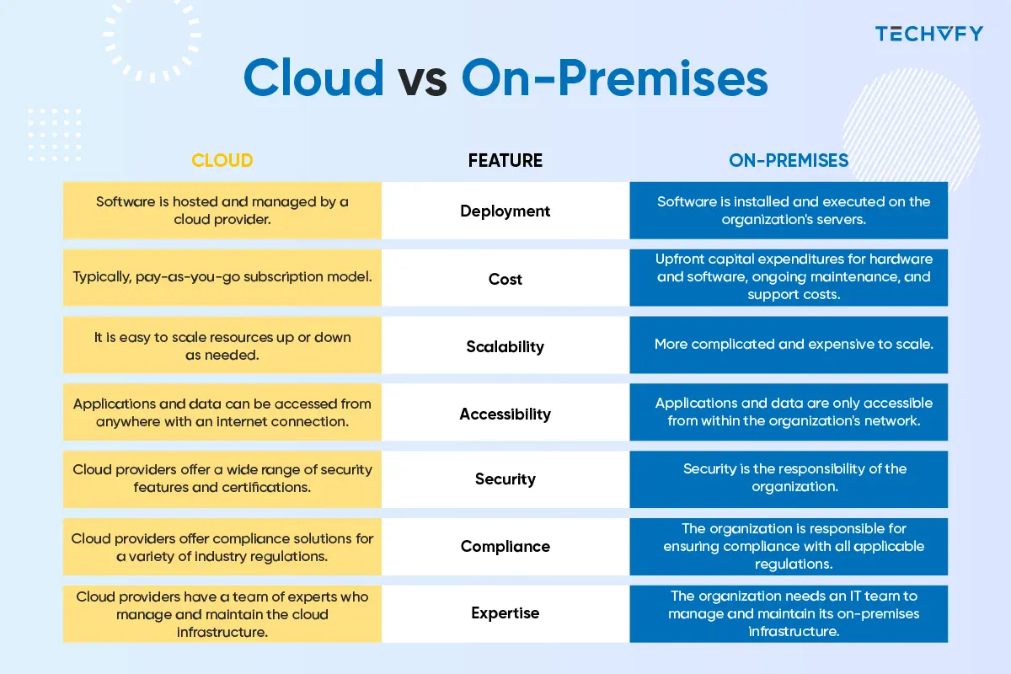

Slide 6
Cloud Access Methods
Portals: Web-based dashboards for cloud service management (e.g., AWS Management Console).
APIs: Programmatic access for automated tasks and integrations.
SDKs: Language-specific libraries (e.g., AWS SDK for Python, Azure SDK for Java).

Slide 7
Cloud Computing Characteristics
Elasticity
Multi-Tenancy
On-Demand Access
Ubiquitous Access
Usage Metering
Self-Service Capability
SLA Monitoring

Slide 8
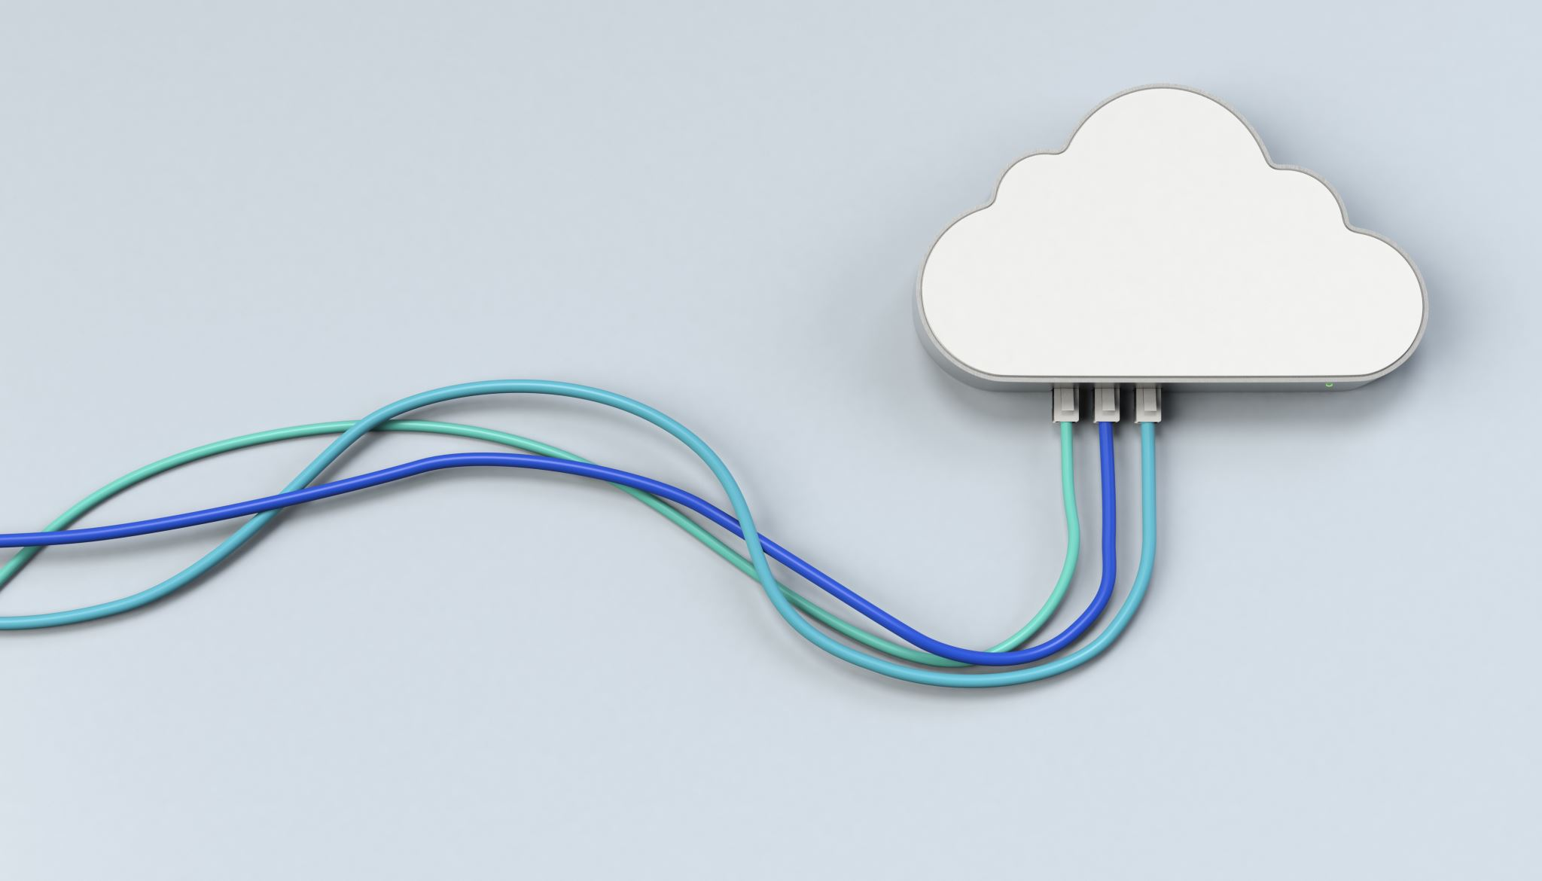
Elasticity
Elasticity refers to the ability to scale computing resources up or down dynamically based on current demand. This means if you have a sudden spike in user activity, the cloud can allocate additional resources automatically, and when demand drops, it reduces the resources to avoid wastage.

Slide 9
Multi-Tenancy
Multi-tenancy is a cloud architecture where multiple users (tenants) share the same physical infrastructure while keeping their data and applications isolated and secure.
A cloud provider like AWS hosts data for multiple organizations on the same server, but each organization's data is accessible only to them.

Slide 10

On-Demand Access
Users can access and use computing resources whenever they need them, without waiting for manual provisioning.
A developer can instantly spin up a virtual server or database instance with just a few clicks in a cloud portal or an API call.
Immediate resource availability.
Faster deployment of applications.
Improved flexibility and agility for businesses.

Slide 11

Ubiquitous Access
Cloud resources can be accessed from anywhere with an internet connection, using any compatible device, like a laptop, tablet, or smartphone.
Employees working remotely can access cloud-based productivity tools like Google Workspace or Microsoft 365 from any location.

Slide 12

Usage Metering
Cloud providers use metering systems to track resource usage, such as CPU, memory, storage, and bandwidth. Users are billed based on their actual consumption.
A cloud provider charges a company for storage in GB, compute power in hours, and data transfer in TB.

Slide 13

Self-Service Capability
Users can independently provision and manage resources through a self-service portal without needing intervention from the service provider’s support team.
A developer can create a virtual machine, configure it, and deploy an application directly from the cloud dashboard or CLI.

Slide 14

SLA Monitoring
Service Level Agreements (SLAs) define the expected level of service, such as uptime, performance, and response times. Cloud providers continuously monitor their systems to meet these commitments.
AWS provides an SLA of 99.99% uptime for certain services. If the uptime drops below this threshold, customers may receive compensation as per the SLA terms.

Slide 15
Service-Oriented Architecture (SOA)
Service-Oriented Architecture (SOA):
Framework for designing and developing software as modular services.
Relationship with Cloud Computing:
SOA principles enhance cloud computing by enabling service reuse, scalability, and flexibility.
Example: Microservices architecture commonly deployed in cloud environments.

Slide 16
Feature | SOA | Monolithic | Microservice | Event-Driven | Layered
Definition | Design paradigm structuring software as modular services communicating via protocols. | Entire application built as a single, unified unit. | Breaks down applications into small, highly specific services. | System communicates using asynchronous events. | Applications divided into layers like presentation, business logic, and data.
Modularity | Medium - Coarse-grained services focused on business processes. | Low - Single deployable codebase. | High - Each microservice handles a single functionality. | High - Components react to and produce events. | Medium - Organized into distinct functional layers.
Scalability | Scalable but may require more effort for inter-service communication. | Limited; scaling requires duplicating the entire application. | Highly scalable; services scale independently. | Highly scalable; can handle real-time workloads efficiently. | Limited; scalability depends on specific layer bottlenecks.
Interdependence | Loosely coupled services with some interdependencies. | Highly interdependent; components tightly coupled. | Loosely coupled with minimal interdependencies. | Minimally coupled; services interact indirectly via events. | Layers interact sequentially; moderately coupled.
Technology Flexibility | Supports heterogeneous technologies with protocols like SOAP/REST. | Requires uniform technology stack. | High flexibility; services can use different technologies. | Flexible; integrates with various messaging technologies (e.g., Kafka). | Relatively inflexible; layers depend on each other.
Use Cases | Enterprise systems, reusable services. | Small-scale applications or systems with simple requirements. | Large-scale, complex systems requiring agility (e.g., Netflix, Uber). | IoT, real-time notifications, stock trading platforms. | Traditional enterprise systems like CRM or ERP.
Advantages | Reusability, flexibility, promotes modular design. | Easy to develop initially, fewer moving parts. | Independent scalability, faster development cycles. | Low latency, resilient, real-time communication. | Clear separation of concerns, simplifies maintenance.
Challenges | Complex governance, potential performance overhead. | Hard to maintain and scale as the application grows. | Complex management; requires orchestration tools. | Debugging/tracing events is challenging; requires robust event handling. | Can introduce inefficiencies due to abstraction layers.

Slide 17
Enterprise Cloud Drivers
Cost reduction (CAPEX to OPEX shift).
Improved scalability and flexibility.
Faster time-to-market for applications.
Enhanced security features provided by cloud providers.

Slide 18

Adoption Trend
Increasing multi-cloud strategies.
Migration to hybrid cloud setups.
Growing reliance on AI and ML services in the cloud.

Slide 19
End of Topic 1

